Slide 1
SEO Implementation: First Stage

Slide 2
Identifying the Site Development Process and Players
Your SEO team should be cross-functional and multidisciplinary, consisting of the
team manager
, the technical team
, the creative team
, the data and analytics
and the major stakeholders from marketing
, advertising and PR

Slide 3
Development Platform & Information Architecture
technology decisions and structural decisions.

Slide 4
Technology Decisions
Dynamic URLs are URLs for dynamic web pages (which have content generated “on the fly” by user requests).
These URLs are generated in real-time as the result of specific queries to a site’s database –
for example, a search for “leather bag” on Etsy.com results in the dynamic search result URL https://www.etsy.com/search?q=leather%20bag.
Etsy also has a static URL for a static page showing leather bags, here: https://www.etsy.com/market/leather_bag

Slide 5
Session IDs or user IDs in the URL
When you run a data-driven site or have other reasons why a document might be duplicated it’s important to tell search engines which copy is the original copy, or in the jargon, the “canonical” copy. When a search engine indexes your pages it can tell when content has been duplicated.
https://ahrefs.com/blog/canonical-tags/
Superfluous parameters in the URL
Links or content based in Flash
Content behind forms
Temporary (302) redirects

Slide 6
Structural Decisions
Target keywords Keyword research is a critical component of SEO. What search terms do people use when searching for products or services similar to yours? How do those terms match up with your site hierarchy?
Cross-link relevant content Linking between articles that cover related material can be very powerful. It helps the search engine ascertain with greater confidence how relevant a web page is to a particular topic
Use anchor text, intuitively :Use descriptive text in your internal links and avoid using irrelevant text such as “More” or “Click here.” Try to be as specific and contextually relevant as possible .
Eg “some of our finest quartz specimens” as anchor text for an internal link, vs. “quality quartz crystals.”

Slide 7

Use breadcrumb navigation :Breadcrumb navigation is a way to show the user where he is in the navigation hierarchy.
Minimize link depth :Standard SEO advice is to keep the site architecture as flat as possible, to minimize clicks from the home page to important content.

Slide 8
Mobile Sites & Mobile Apps :
If you are building a website, you need to build a mobile version if you want to take full advantage of organic search through SEO – and depending on your business, you may benefit from developing a mobile app as well.
The main consideration regarding your site’s mobile version is whether to host the mobile version on same or separate URLs as your desktop version

Slide 9
Auditing an Existing Site to Identify SEO Problems
Elements of an Audit Your website needs to be a strong foundation for the rest of your SEO efforts to succeed.
An SEO site audit is often the first step in executing an SEO strategy.
Both your desktop and mobile site versions need to be audited for SEO effectiveness.

Slide 10
Page load time
Is the page load time excessive? Too long a load time may slow down crawling and indexing of the site – and can virtually eliminate your site from competitiveness in mobile search.
Mobile-friendliness
Your site should have a fast, mobile-friendly version that is served to mobile devices.
Usability
Usability affects many factors, including conversion rate as well as the propensity of people to link to a site.
Accessibility/spider-ability
Make sure the site is friendly to search engine spiders “Making Your Site Accessible to Search Engines”

Slide 11
Search engine health check
• Perform a site:yourdomain.com search in the search engines to check how many of your pages appear to be in the index. Compare this to the number of unique pages you believe you have on your site. Also, check indexation numbers in your Google and Bing Webmaster Tools accounts.
• Check the Google cache to make sure the cached versions of your pages look the same as the live versions of your pages.
• Check to ensure major search engine Webmaster Tools ” have been verified for the domain (and any subdomains, for mobile or other content areas). Google and Bing currently offer site owner validation to “peek” under the hood of how the engines view your site).
• Test a search on your brand terms to make sure you are ranking for them

Slide 12
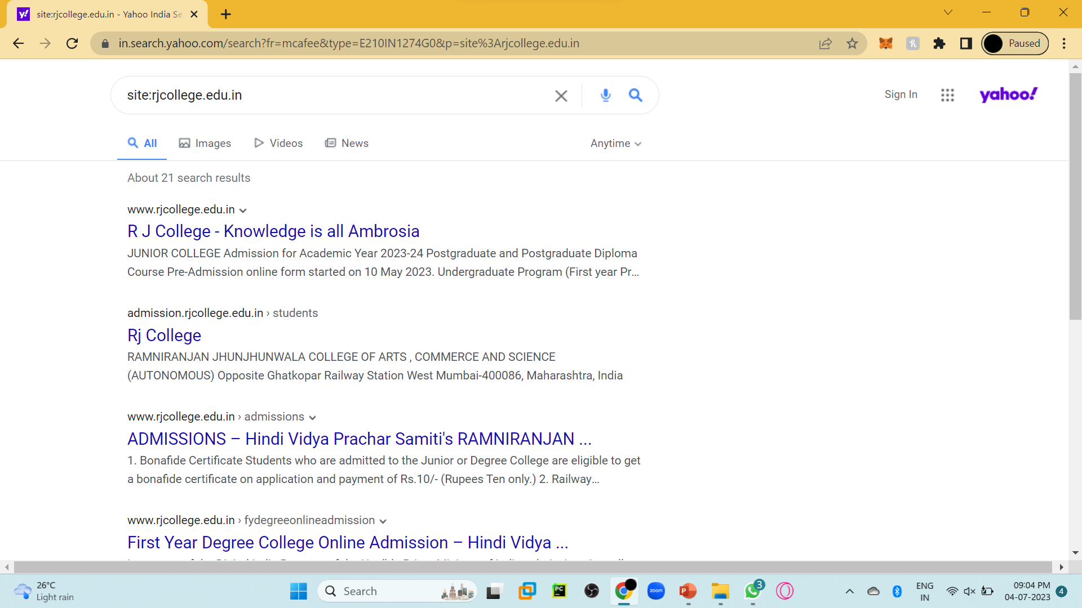

Slide 13
Keyword health checks
Are the right keywords being targeted?
Does the site architecture logically flow from the way users search on related keywords?
Does more than one page target the same exact keyword (a.k.a. keyword cannibalization)?
Search engine optimization involves inserting certain keywords for your domain’s subpages. When doing this, it’s best not to reuse individual search phrases or sets of keywords
An important fundamental SEO principle is to ensure particular keywords are reserved for one specific URL only. If you work with the same keywords on multiple subpages, however, we call this keyword cannibalization

Slide 14
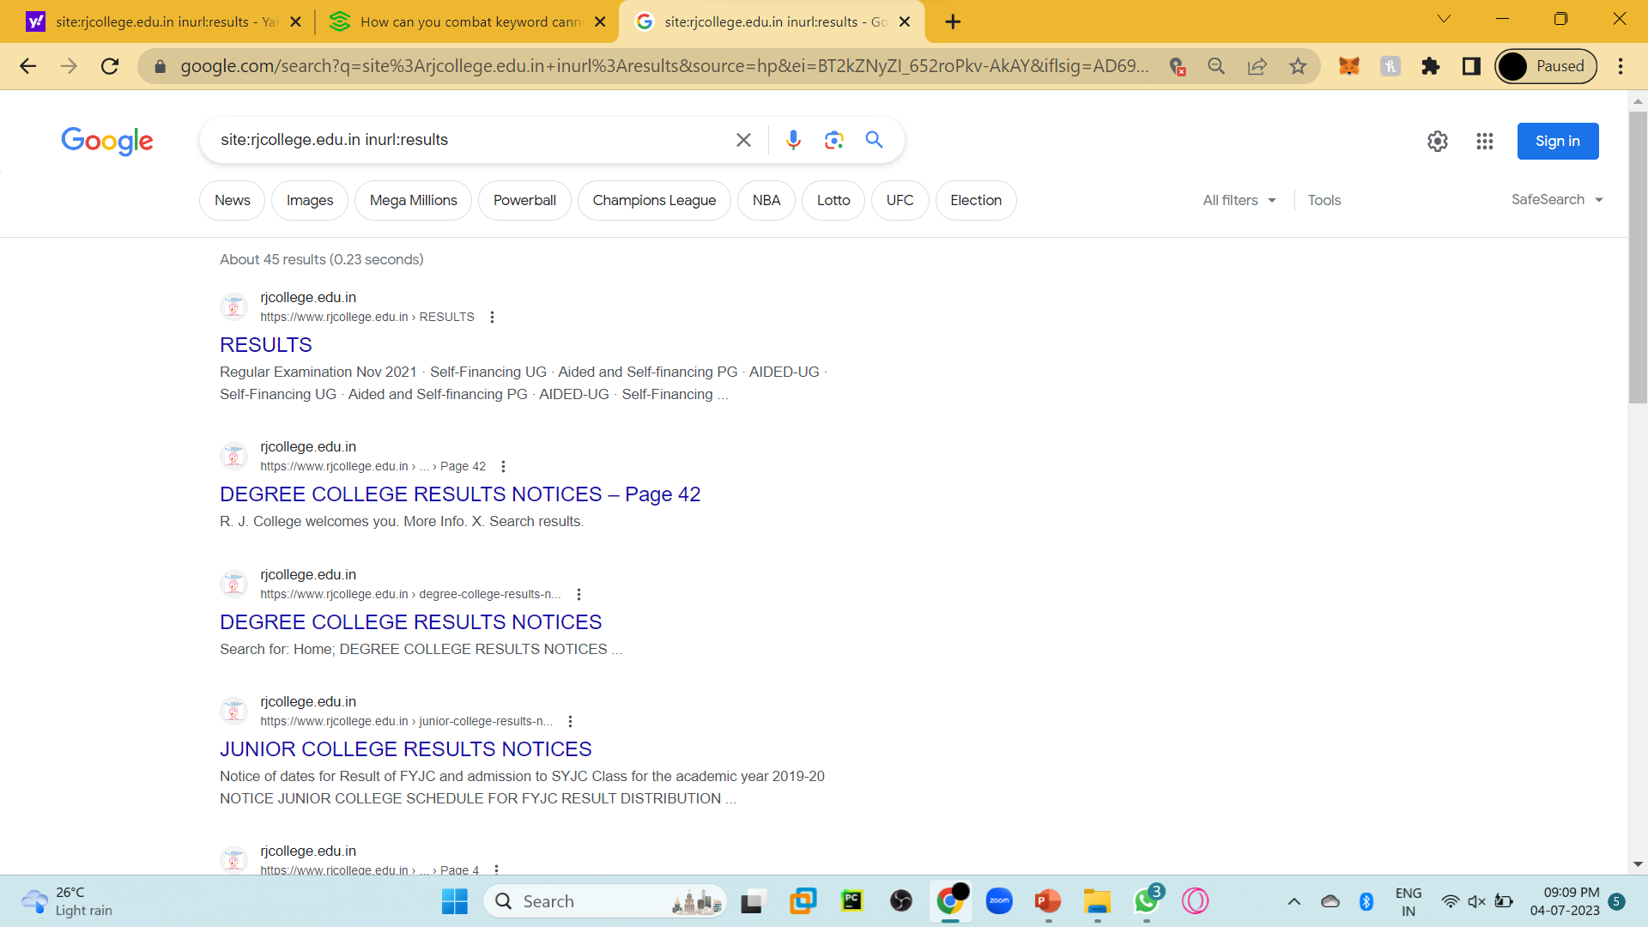

Slide 15
The crawler can no longer identify a unique URL for the corresponding semantic context. This can result in ranking drops and wastes potential
Your domain may be indexed with multiple URLs under one search term. Users arrive at different content on the same topic
Duplicate rankings complicate SEO analysis and reporting.

Slide 16
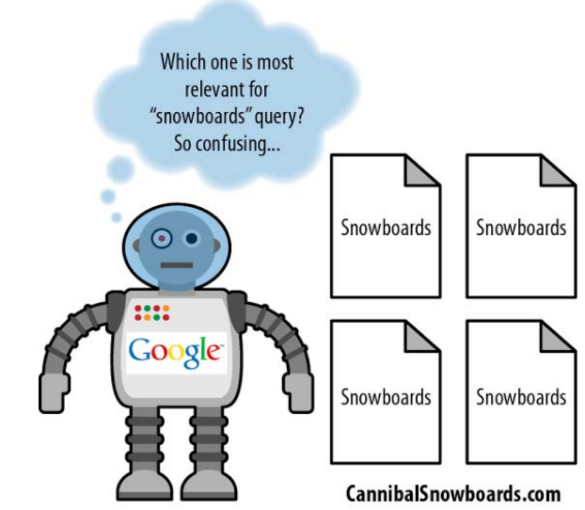
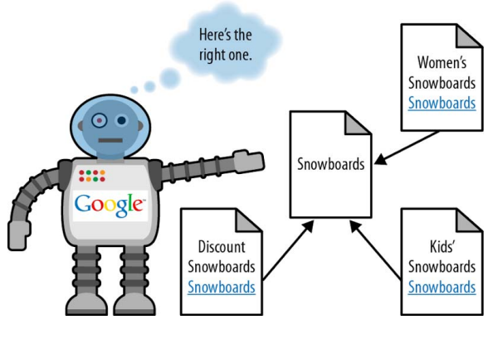
Keyword Cannibalization

Slide 17
Duplicate content checks
The first thing you should do is to make sure the non-www versions of your pages (i.e., http://yourdomain.com) 301-redirect to the www versions of your pages (i.e., http://www.yourdomain.com), or vice versa (this is often called the canonical redirect). While you are at it, check that you don’t have https: pages that are duplicates of your http: pages.
301 is an HTTP status code sent by a web server to a browser. A 301 signals a permanent redirect from one URL to another, meaning all users that request an old URL will be automatically sent to a new URL. A 301 redirect passes all ranking power from the old URL to the new URL, and is most commonly used when a page has been permanently moved or removed from a website.

Slide 18
URL check
Make sure you have clean, short, descriptive URLs.
Descriptive means keyword-rich but not keyword stuffed
eg. site.com/outerwear/mens/hats is keyword rich; site.com/outerwear/mens/hat-hats-hats-for-men is keyword-stuffed!).
You don’t want parameters appended

Slide 19
HTML title tag review
Make sure the title tag on each page of the site is unique and descriptive.
60 characters long
Give every page a unique title
Put important keywords first
https://www.seoptimer.com/blog/title-tag/

Slide 20
Meta tag review
Sitemaps file and robots.txt file verification
URL redirect checks
Internal linking checks
Avoidance of unnecessary subdomains
Geolocation
External linking
Image alt attributes
Code quality

Slide 21
The Importance of Keyword Reviews
Step 1: Keyword research
Step 2: Site architecture
Step 3: Keyword mapping
Step 4: Site review

Slide 22
backlinks
https://backlinko.com/hub/seo/backlinks

Slide 23
Link Juice
https://www.woorank.com/en/edu/seo-guides/link-juice
https://mangools.com/blog/nofollow-dofollow-links/#:~:text=devalue%20certain%20links.-,Nofollow%20vs.,as%20%E2%80%9Clink%20juice%E2%80%9D).
https://www.inseev.com/blog/what-is-link-juice/
To learn various terms in brief
https://www.searchmetrics.com/glossary/link-juice/

Slide 24
Server and Hosting Issues
Server timeouts
Slow response times
Shared IP addresses
Blocked IP addresses
Bot detection and handling
Bandwidth and transfer limitations
Server geography

Slide 25
Identifying Current Server Statistics Software and Gaining Access
Web Analytics
Analytics software can provide you with a rich array of valuable data about what is taking place on your
site. It can answer questions such as:
• How many unique visitors did you receive yesterday?
• Is traffic trending up or down?
• What site content is attracting the most visitors from organic search?
• What are the best-converting pages on the site?

Slide 26
Logfiles contain a detailed click-by-click history of all requests to your web server.
Make sure you have access to the logfiles and some method for analyzing them.
If you use a third-party hosting company for your site, chances are it provides some sort of free logfile analyzer, such as AWStats
(http://awstats.sourceforge.net),
Webalizer (http://www.webalizer.com), or something similar (the aforementioned Piwik also provides a log analytics tool, as well)

Slide 27
From a planning perspective, you will want to get these tools in place as soon as possible. Both tools
provide valuable insight into how the search engines see your site, including things such as external link
data, internal link data, crawl errors, high-volume search terms, and much, much more

Slide 28
https://www.semrush.com/blog/website-structure/

